Slide 1
The Liability Investigation
-Jordan Roberts

Slide 2
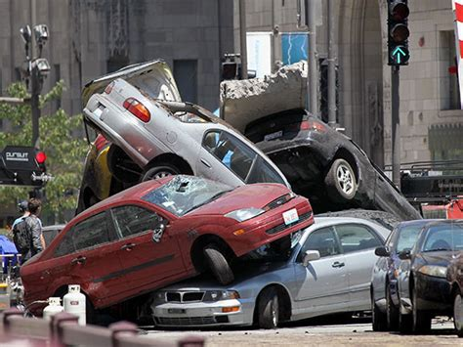
Investigate?

Slide 3
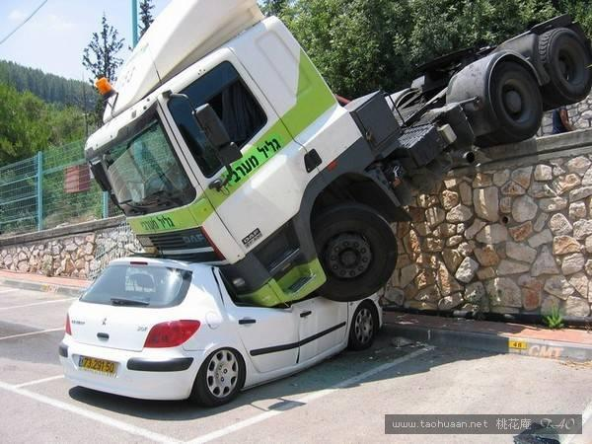
Investigate?

Slide 4
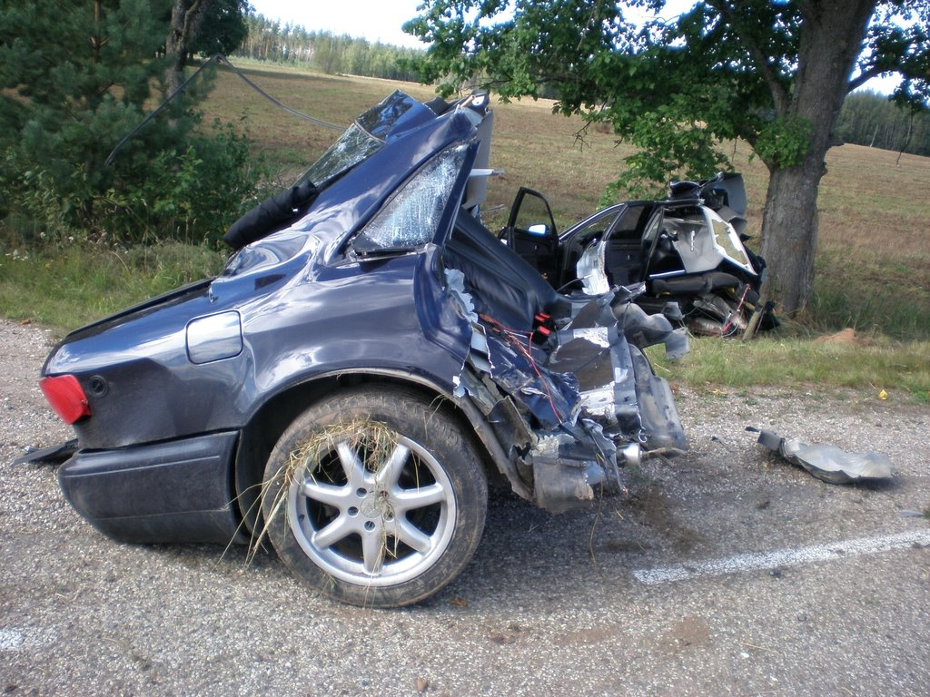
Investigate?

Slide 5
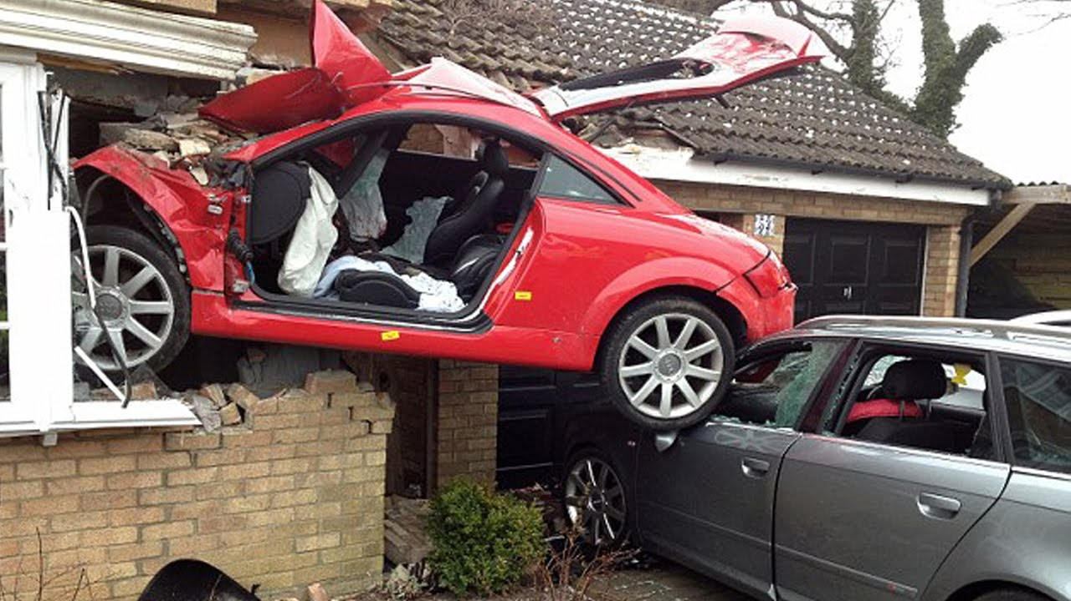
Investigate?

Slide 6
Investigations…
We investigate when we need to know what took place.
When you look at a picture or you read a loss description, can you understand who did what leading up to the accident?
If not, you need to investigate.

Slide 7
Definitions
Investigate:
An investigation is a systematic, minute, and thorough attempt to learn the facts about something complex or hidden; it is often formal and official (dictionary.com)
To try to find out the facts about (something, such as a crime or an accident) in order to learn how it happened, who did it, etc. (merriam-webster.com/dictionary)

Slide 8
Definitions
Liability:
legal responsibility for one's acts or omissions (dictionary.law.com)
responsibility that someone has for their actions, for example the responsibility to pay another person for harm or damage that is a result of these actions (dictionary.Cambridge.org)

Slide 9
Why investigate?
Our objective as an insurer is to settle claims in a fair manner at the earliest possible time.
The purpose of investigating is to secure necessary facts to allow us to do just that.
Notes:
And why might we need facts? What’s our end goal? To settle claims.

Slide 10
When do we investigate?
Coverage Issues
Complicated Accident Scenarios
Suspicious Circumstances
Questionable Liability or Injuries

Slide 11
Complicated or not?

Slide 12
Complicated or not?

Slide 13
Complicated or not?

Slide 14
How do we investigate?
1. Assess the Situation
2. Make Contact with Everyone
3. Obtain Documentation
4. Review Vehicle Damages
5. Assess Liability
6. Handle Accordingly

Slide 15
Investigation: 1. Assess the Situation
Understand the scene, number of vehicles, and any injuries that make up the accident/aftermath.
This may require a file review, news reports, or talking it through with someone involved.
When we fully understand the situation, we should begin with a mental/paper “to do list.”

Slide 16
Investigation: 2. Make Contact
We will want to introduce ourselves to everyone and explain the process from here simply.
If we reach the drivers, passengers, witnesses, etc., is we should attempt to secure a recorded statement.
Make sure everyone leaves the discussion knowing what to expect.

Slide 17
The Recorded Statement
This is a permanent account of what happened in the loss. This will guide us as the party’s “official” account of the accident.
Be sure we do proper introductions to identify us/the customer and obtain formal permission to record before we discuss the accident.
Ask questions! As many as you need to understand what happened!

Slide 18
Investigation: 3. Obtain Evidence
Although the recorded statement is evidence, we group that in with the contact piece.
This may include independent accounts of the loss via dash cam video, store security video footage, witness statements, etc.
It can also include post-loss investigation tools such as scene photographs prior to moving vehicles, police reports, etc.

Slide 19
The Infamous Police Report
Is a police report necessary? It depends. If the officer did not see the loss, they are doing exactly what we are doing.
That being said, they may have seen more than you can see.
Asking all drivers what the police concluded or said can help us know if we need it.

Slide 20
Investigation: 4. Review Vehicle Damage
This step may or may not be necessary, depending on the nature of the loss.
If everyone agrees about the damage, you may be able to proceed without seeing the damage.
It never hurts to get photographs of the damage, though!

Slide 21
Investigation: 5. Assess Liability
This is where the grey area comes in. Who did something they should not have done? Who didn’t do what they should have done?
This is also subjective. If you ask a dozen claims adjusters, attorneys, police officers, etc. who was at fault, every one may give you a different answer.
There are some situations that are obvious but anytime we investigate, there may Be complexity to the situation.

Slide 22
Investigation: 5. Assess Liability continued…
We should always start with “who did what?” questions and end with percentages.
We assign percentages based on severity of the action. Not honking one’s horn to alert another may be a small percentage while running a red light may be high.

Slide 23
Investigation: 6. Handle Accordingly
After reaching a decision, let everyone know and thoroughly explain our basis for the decision.
If we owe damages, handle them promptly. If we are denying payment of damages, ensure we send the same in writing.

Slide 25
References:
Photographs, in order of appearance
http://www.funnypica.com/wp-content/uploads/2015/06/Funny-Car-Accidents-9.jpg
http://cimg.taohuaan.net/upload/201204/19/124940JiIxt.jpg
http://1.bp.blogspot.com/-pzx3Asj50jM/UJ-4s-6nzuI/AAAAAAAAoG0/2b62pIMIFtI/s1600/strange+car+accidents+(4).jpg
https://i.ytimg.com/vi/vF99S02R_8Y/maxresdefault.jpg
http://2.bp.blogspot.com/-CaZehcdQVd4/Txw71Uq_F4I/AAAAAAAABAE/fuSsrNB4A5E/s400/crazy-car-accidents+7.jpg
https://i.pinimg.com/736x/e0/ac/ca/e0acca7537e132c7ecd1e83cf044e945--crazy-cars-car-crash.jpg
http://www.thesupercars.org/wp-content/uploads/2009/05/car-crash.jpg

