Slide 1
Legal Liability
-Jordan Roberts

Slide 2
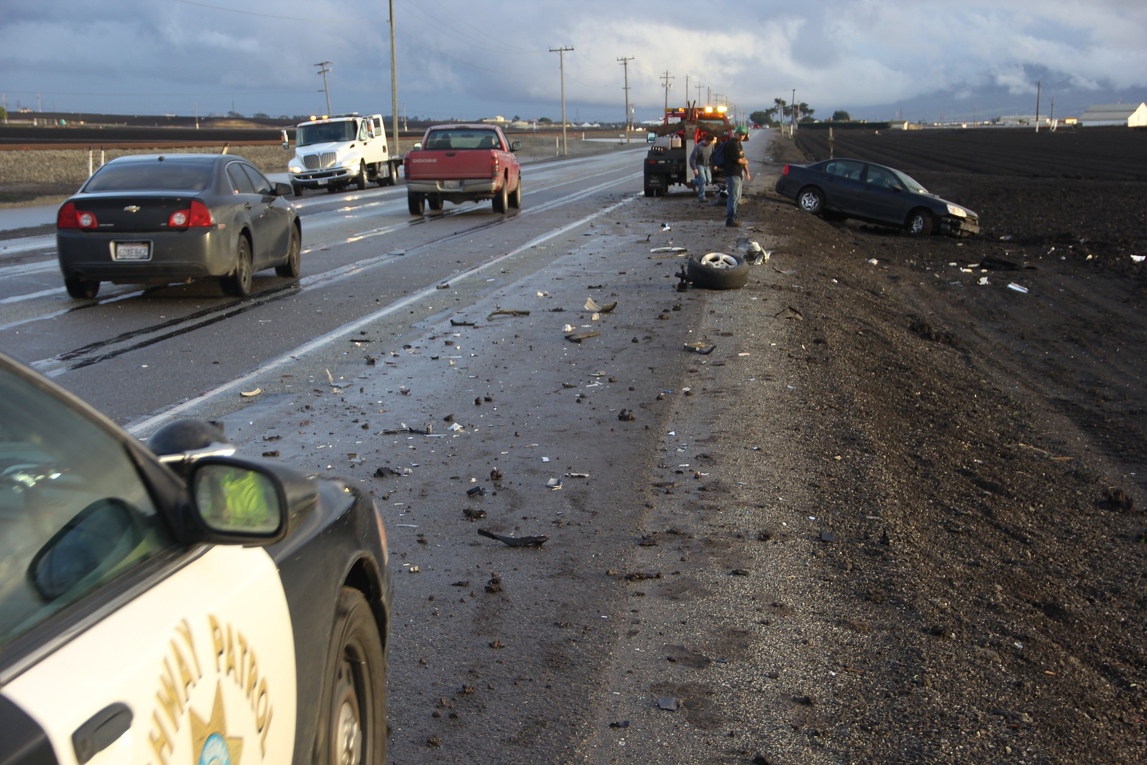
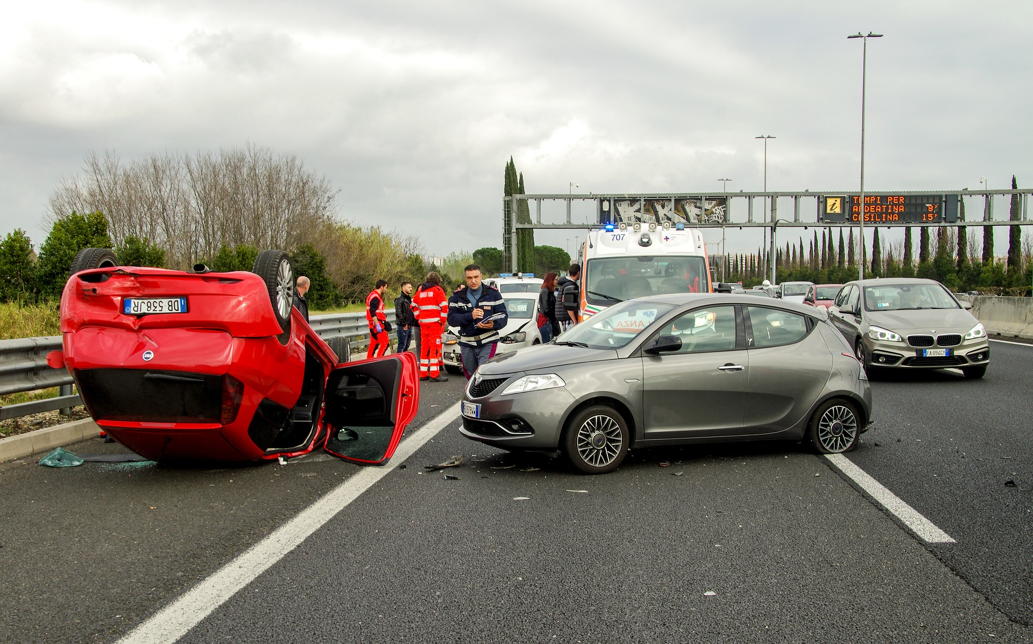
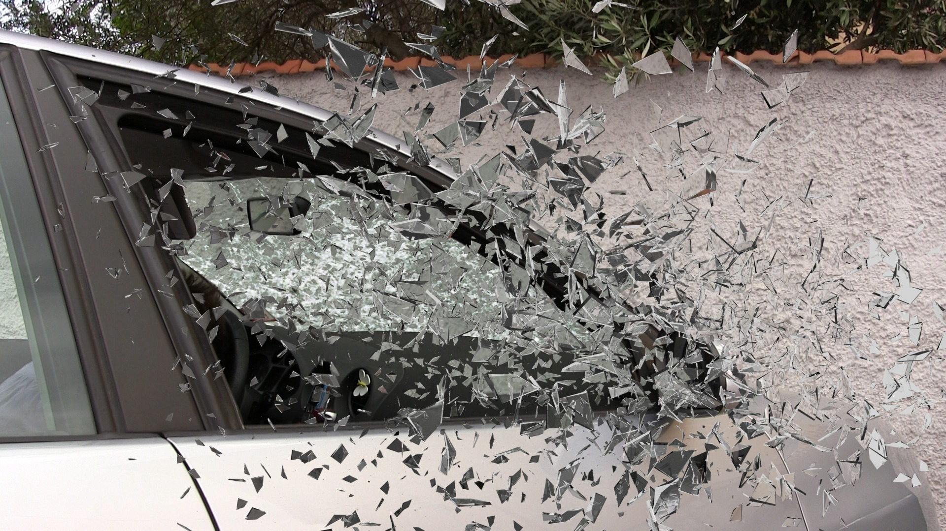

Slide 3
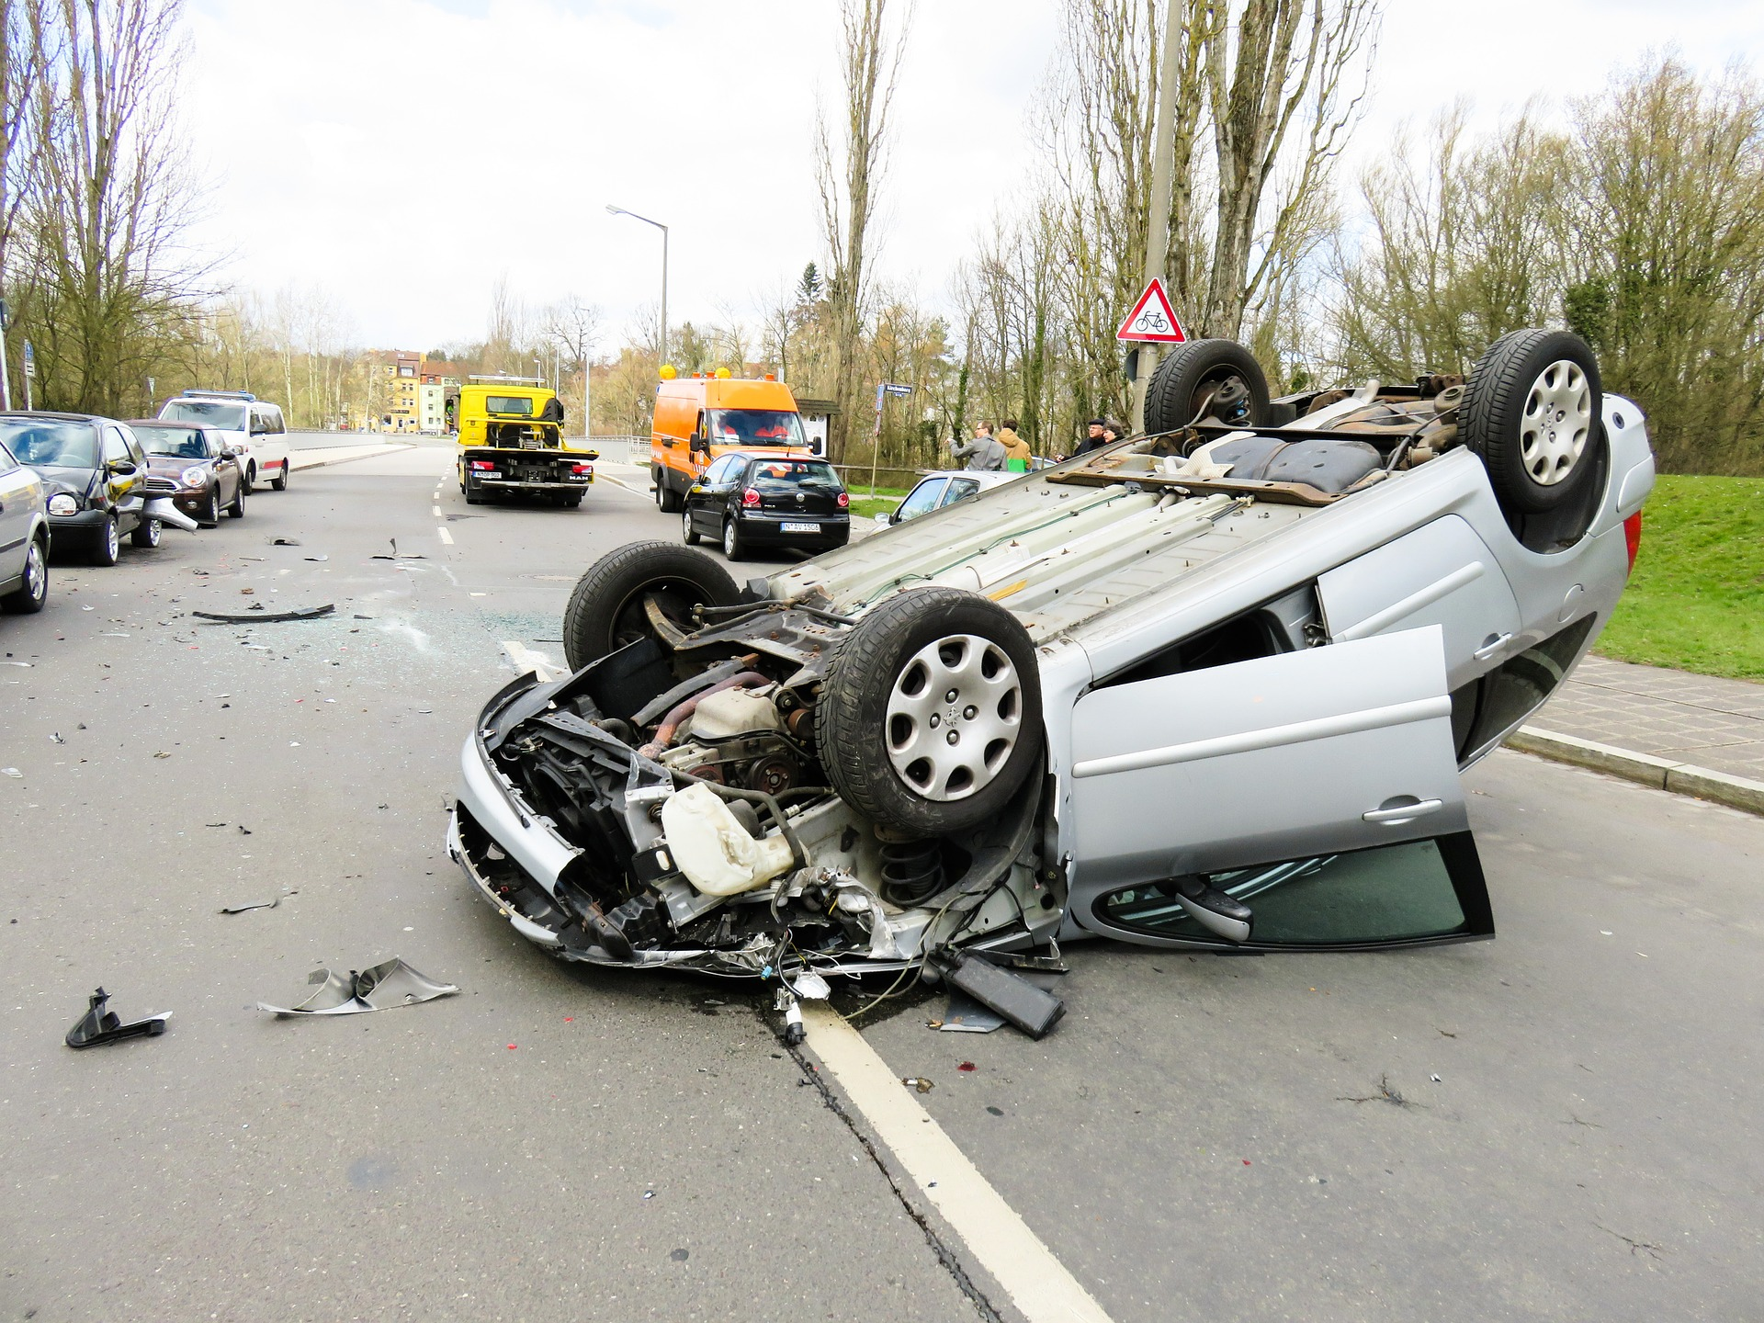
If this customer calls you…
What do you do?

Slide 4
We investigate liability
Legal Liability:
“one of the most significant words in the field of law, liability means legal responsibility for one's acts or omissions. Failure of a person or entity to meet that responsibility leaves him/her/it open to a lawsuit for any resulting damages” (dictionary.law.com).
“In insurance law, liability often is used to refer to blameworthiness that is used to apportion responsibility for repairing damage caused” (definitions.uslegal.com).

Slide 5
Definitions
Negligence:
“Negligence is the failure to use reasonable care. Negligence may consist of action or inaction. A person is negligent if he fails to act as an ordinarily prudent person would act under the circumstances” (definitions.uslegal.com).
“A failure to behave with the level of care that someone of ordinary prudence would have exercised under the same circumstances. The behavior usually consists of actions, but can also consist of omissions when there is some duty to act” (law.cornell.edu).

Slide 6
The 4 elements of liability
1. Duty Owed
2. Duty Breached
3. Proximate Cause
4. Damages
Notes:
And why might we need facts? What’s our end goal? To settle claims.

Slide 7
The 4 elements of liability
These are what govern if a party can collect in a negligence lawsuit.
If all 4 are proven, an award is likely.
If one component is missing, the plaintiff (lawsuit filer) will probably not receive money.
Notes:
And why might we need facts? What’s our end goal? To settle claims.

Slide 8
1. Duty Owed
What does it mean? Every driver or pedestrian has a responsibility to do or not do certain actions to the other drivers and pedestrians on the road.
How does it work? You have a duty to keep a certain space from the car in front of you while driving. You have a duty to make a right turn from the right turn lane, not the left turn lane. Etc.

Slide 9
2. Duty breached
What does it mean? This unfortunate situation is when a driver of pedestrian fails to do or avoid certain actions to others on the road.
How does it work? As noted above, you do not keep necessary space from the car in front of you and rear-end the car. You make a right turn from the left turn lane and strike another car making the proper, legal turn.

Slide 10
How is a duty determined?
Traffic laws and statutes
Reasonable, prudent person
Street signs or lack thereof
Customs of the area
Driver’s education

Slide 11
3. Proximate Cause
What does it mean? This is the closest factor to causing an accident. Your action of following too closely to the car in front of you is the proximate cause of you rear-ending it. Your action of turning right from the left turn lane is the proximate cause of that accident.
How does it work? The best way to describe this is by way of a chain. All actions in the chain lead to the accident. What one link in the chain, if broken, prevents the accident from happening more than any other link? That is the proximate cause.

Slide 12
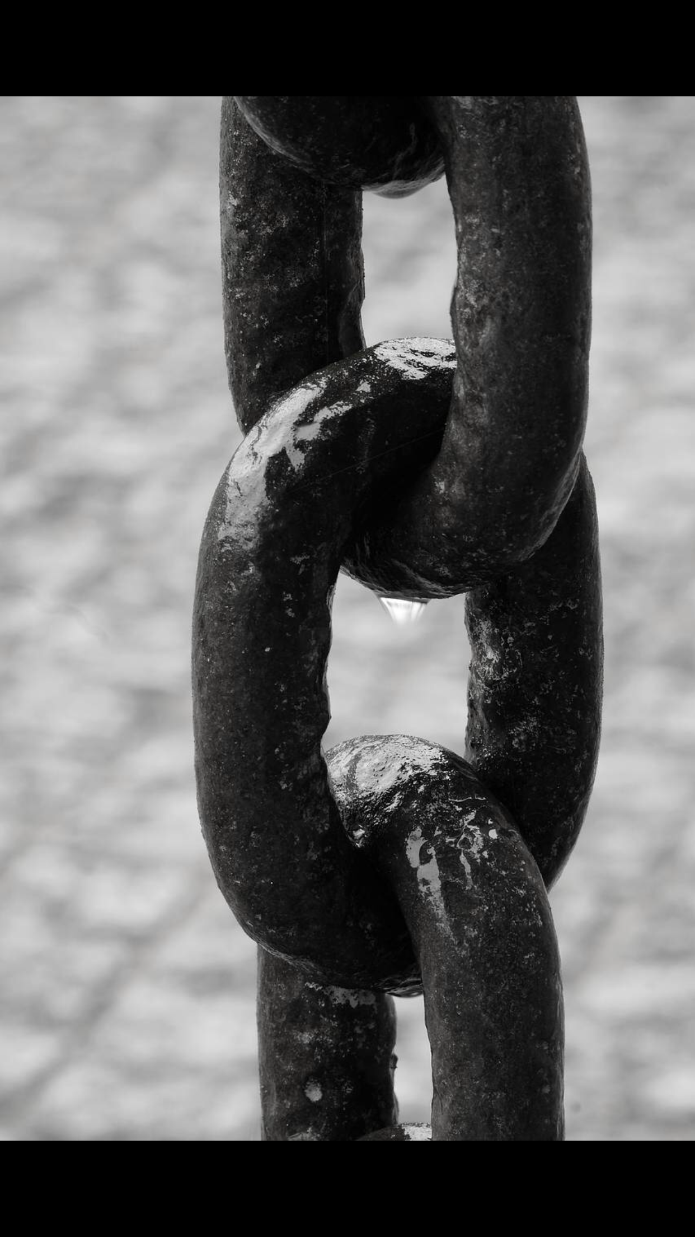
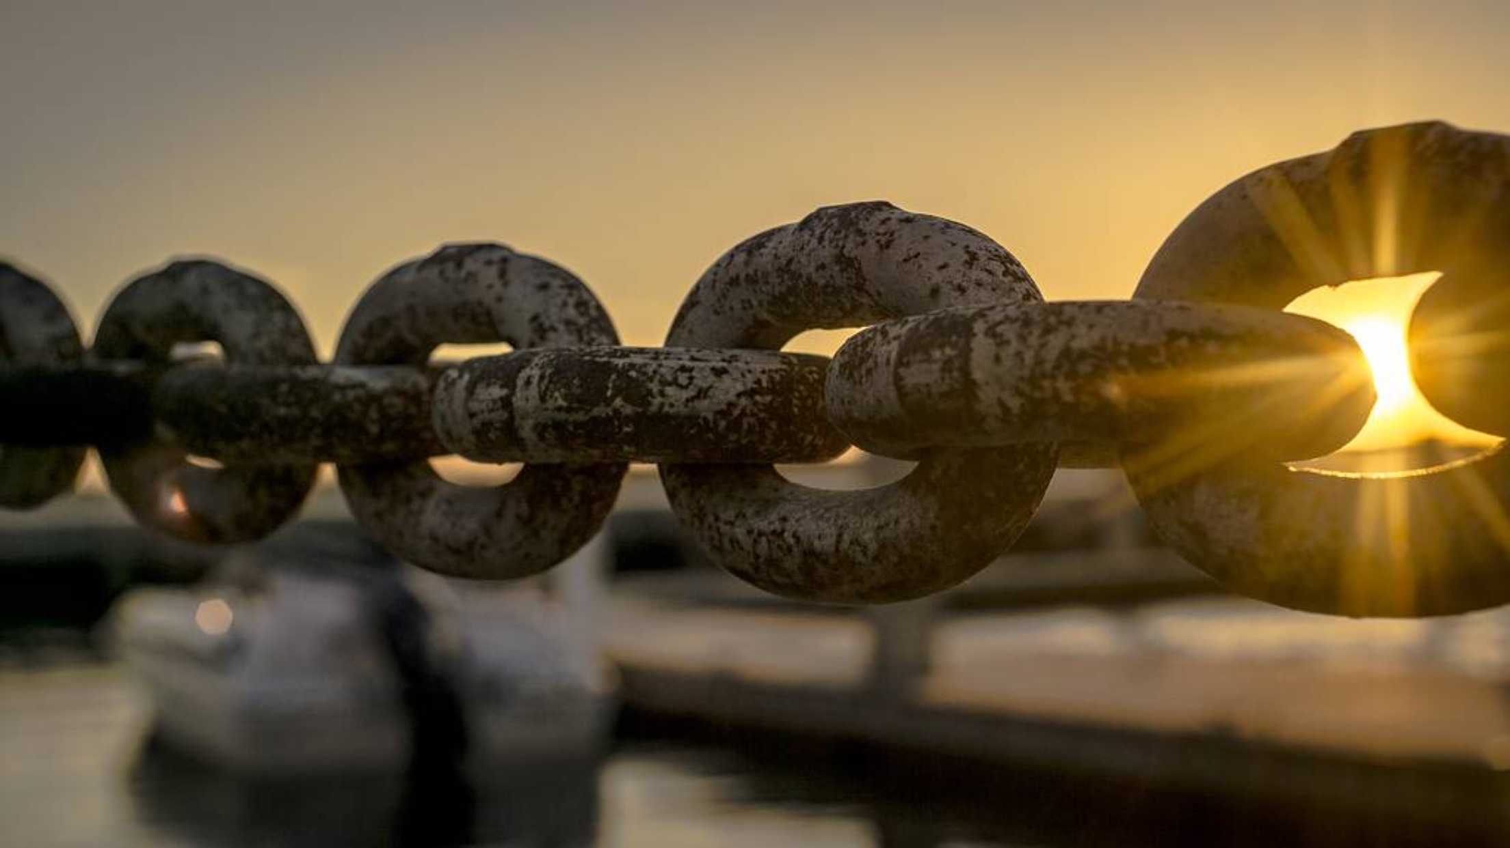
3. Proximate Cause

Slide 13
3. Proximate Cause
This is a tough concept so let’s do some review and research about it.
“[Proximate cause] is an act or omission that is considered in law to result in a consequence, so that liability can be imposed on the actor. It is the cause that directly produces an event. The event would not have occurred but for the cause (definitions.uslegal.com).
Hint - there can be more than one proximate cause. If two cars back out of parking spaces simultaneously and collide in the middle of a parking lot, both drivers’ inattentive backing = the proximate cause

Slide 14
3. Proximate Cause Examples…
You back out of your parking spot and begin traveling down the parking aisle. You don’t see a large vehicle parked with its rear tire sucking out of the spot and run into it. What’s the proximate cause?
You are going 50 mph in a 45 mph zone and enter an intersection on a green light when the other driver runs his red light and strikes you. What is the proximate cause?
Does the answer above change of you are going 80 mph in a 45 mph zone?

Slide 15
4. Damages
What does it mean? Damages are real expenses one incurs as a result of an accident.
Technically, the direct result of owing/breaching a duty and holding the proximate cause are damages.
How does it work? Using the scenarios above, the rear bumper of the car you rear-ended is damage. The side of the vehicle you turn into is damage. Injuries can also be considered damages.

Slide 16
Is this black and white or grey?
It’s all grey-vy… It is subjective because the proximate cause may or may not be clear.
There can be multiple proximate causes or (in the case of an almost-accident) no proximate cause.
Liability is clear and final after a judge or jury issues a ruling in a lawsuit but not until then. Liability may change as we gather more information about an accident (more on that in the next lesson).

Slide 17
Comparative Negligence: Multiple Proximate Causes
You will encounter many situations where there are multiple proximate causes. We will discuss them in detail in upcoming lessons.
In general, the causes are weighed in severity against one another.
When there are two parties somewhat at-fault for a loss, we call is comparative negligence. States vary in how they allow for and handle this concept.

Slide 19
References:
Photographs, in order of appearance
http://dictionary.law.com/Default.aspx?selected=1151
Liability Law and Legal Definition. https://definitions.uslegal.com/l/liability/
Negligence Law and Legal Definition. https://definitions.uslegal.com/n/negligence/
Negligence. https://www.law.cornell.edu/wex/negligence
Proximate Cause Law and Legal Definition. https://definitions.uslegal.com/p/proximate-cause/

