Slide 1
Efficiency for Management
Instructor/Designer: Jordan Roberts

Slide 2
Part 1: Efficiency 101 (Adjuster Training)
Instructor/Designer: Jordan Roberts

Slide 3
What It Takes to Succeed… In This Course
Openness… “You can only grow if you’re willing to feel awkward and uncomfortable when you try something new.” – Brian Tracy. You need to be willing to implement what we discuss and try new things.
Honesty… “I’d rather be honest than impressive.” – Unknown . If you pretend to have it all together, you cannot learn from others’ experiences and they cannot learn from yours.
Courtesy… “Life is not so short but that there is always time for courtesy.” – Ralph Waldo Emerson. Exercise professionalism and courtesy in all class interactions and consider the golden rule in your interactions.

Slide 4
Intro
I have been in your shoes, nearly buried alive under work.
I made it to the other side and I assure you… THERE IS HOPE

Slide 5
Definitions
Efficiency – completing a task with great speed; not wasting time.
Accuracy – completing a task the right way, the first time.
Multitasking – completing multiple tasks at the same time.
Framework – an organizational system designed to stay focused and on-task.

Slide 6
Efficiency

Slide 7
What is Efficiency?
Efficiency is completing a task with great speed; not wasting time.
Dictionary.com: “performing or functioning in the best possible manner with the least waste of time and effort.”
Let’s break it down further… There are a handful of speeds with which you can approach a task:
SLOW…
Average…
FAST!

Slide 8
What Characterizes
SLOW?
Double or Triple-Checking Work
Searching for Buttons or Functions
DISTRACTIONS / Lack of Focus
Not Knowing Where to Start

Slide 9
What Characterizes
Average?
Neither Slow nor Fast
Normal Working Pace – No Delay but No Urgency
Moderate Level of Focus
Knowing Where to Start but Occasional Trouble Starting

Slide 10
What Characterizes
FAST?!
Working with Speed
Quick Working Pace; Driven by Urgency
Highly-Focused
Starting Immediately
“Git ‘R Done” Mentality

Slide 11
What Hinders Us from Being
FAST?!
Distractions → they are evil in a fast-paced workplace
Motivation → harder to maintain on difficult days
Hopping Around → we’ll discuss multitasking later; it can help and hinder
Forgetting Priority → any time spent searching for the next task is wasted
Lack of Confidence → this leads to double-triple checking,
searching for confirmations, etc.

Slide 12
Steps to Be Efficient /
FAST!
Maintain Laser Focus…
Find Your Internal Motivation
Multitask When Necessary, Not 24 / 7
Always Know Priority & What to Do Next
Study, Ask Questions, Become an Expert to Discover Confidence

Slide 13
When Efficiency Met Accuracy

Slide 14
"Harry Burns: I've been doing a lot of thinking, and the thing is, I love you.
Sally Albright: How do you expect me to respond to this?
Harry Burns: How about, you love me too.
Sally Albright: How about, I'm leaving."
- When Harry Met Sally, 1989

Slide 15
What is Accuracy?
As we discussed in the Course Intro… Accuracy – completing a task the right way, the first time.
Dictionary.com: “the condition or quality of being true, correct, or exact.
The Million-Dollar Question is:
Efficiency & Accuracy:
Match Made in Heaven or Mortal Enemies?

Slide 16
What Characterizes
Accuracy?
Corect, Nminal Erros (← the opposite of that)
Precise
Not Always Perfect but Pretty Close
Following the Process As Trained

Slide 17
What Characterizes
Inaccuracy?
Moderate to Significant Errors
Not Correct, Untrue
Far from Perfect
Multiple Mistakes

Slide 18
What Hinders Us from Being
Accurate?
Efficiency… Yes, I said it… (more on this in a minute)
Knowledge Gaps → not knowing the correct way to do something
Hopping Around → same as efficiency; it can help and hinder
Forgetting Priority → any time spent searching for the next task is wasted
Failure to Proofread or Review → double and triple checking not necessary; single checking is, though.

Slide 19
It’s a Balancing Act…

Slide 20
Steps to Be
Efficient AND Accurate
Do It Right the First Time (minimize redo’s!)
Know Which Corners to Cut
Prioritize – What is CTQ (a concept from Lean Six Sigma – Critical To Quality)
Know the Desired End Result – Look for Alternate Routes to Get There
Ask an “Expert” (someone who has already mastered the balance)

Slide 21
Simultaneous Combustion: The Art of Multitasking

Slide 22
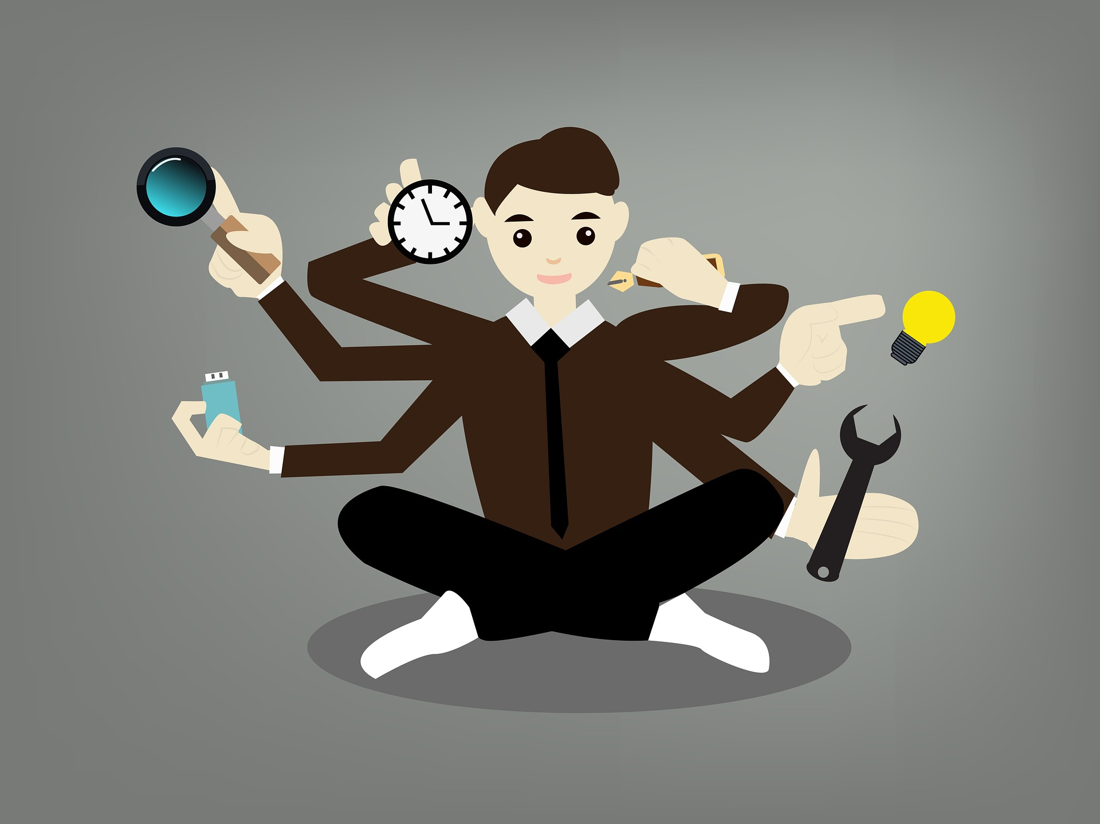
What is Multitasking?
As we discussed in the Course Introduction, multitasking is completing multiple tasks at the same time.
Dictionary.com: “to execute two or more jobs concurrently
Sounds simple enough, right? But the difficulty most of us have with multitasking begs the question, why is it so hard?

Slide 23
Is Multitasking Even Possible?
Research shows that, in actuality, true multitasking is not possible for the human brain.
According to Neuroscientist Earl Miller:
"People can't multitask very well, and when people say they can, they're deluding themselves… [and] the brain is very good at deluding itself.“
"Switching from task to task, you think you're actually paying attention to everything around you at the same time. But you're actually not… You're not paying attention to one or two things simultaneously, but switching between them very rapidly.“
(Miller, E., 2008)

Slide 24
What We Need
Unless you are Superman, multitasking is not the solution to our efficiency problem.
We need what I call “pseudo-multitasking tricks.”

Slide 25
What is a “Pseudo-Multitasking Trick”
While there is no technical, Dictionary.com definition, our working definition will be as follows:
Tools to help us switch between unrelated tasks with greater speed than without them
We will study such tricks from an insurance (desk job) perspective; however, you can create your own tricks in your industry with an innovative spirit.

Slide 26
Our Toolbelt of Pseudo-Multitasking Tricks
We will discuss Supervisor versions of pseudo-multitasking tricks in Part 2 later…
Adjuster tricks:
Trick #1 – Color-coded browser windows and word processors
Trick #2 – Using a OneNote to note your stopping point before switching
Trick #3 – Using Two Browsers Side-by-Side
Trick #4 – Work Diary While Working on Certain Tasks

Slide 27
To Frame or Not To Frame: The Framework

Slide 28
What is a Framework?
A framework – an organizational system designed to stay focused and on-task.
Dictionary.com: “a skeletal structure designed to support or enclose something.”

Slide 29
Why a Framework?
Our job requires an extreme level of focus.
Can we maintain that focus without tools to sustain it? It can be done but it is incredibly difficult.
The smarter choice is to design a system to sustain your focus – a framework

Slide 30
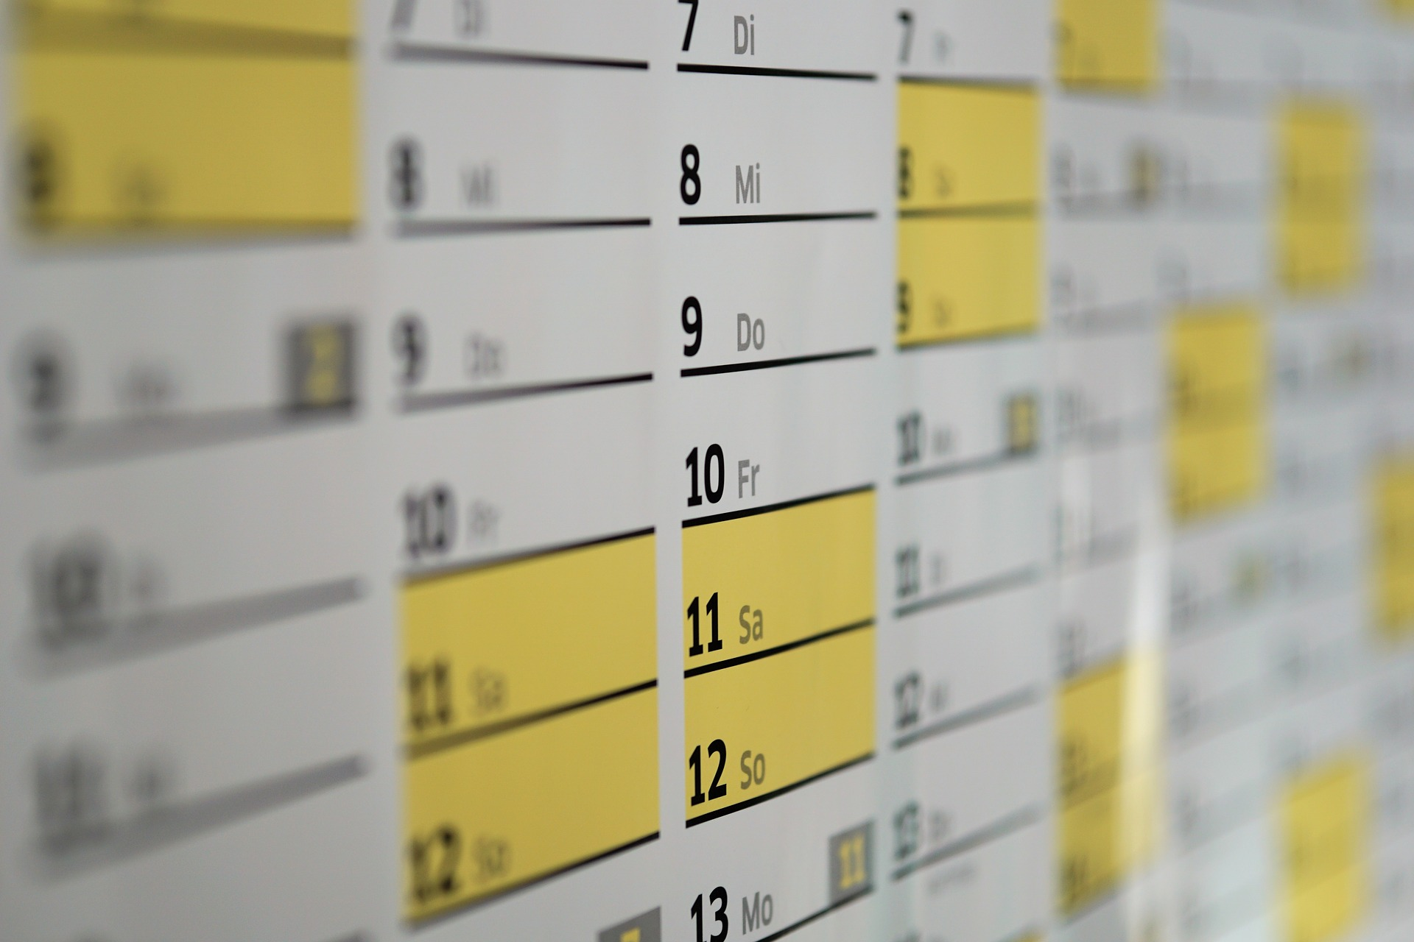
The Framework
A framework is essentially a schedule for a day, drafted based upon priority to help one maintain focus for an extended period of time.

Slide 31
A Framework Is:
Structured / Scheduled
Realistic – No 15 minute slots for something that takes an hour
Intelligent – Plan around phone volume trends
Loose – Leaves Room for the Unexpected

Slide 32
What Does a Framework Look Like?
Framework Examples…
8:00 a.m. | Team Meeting
8:30 a.m. | Return Voicemails
9:00 a.m. | Task A
9:30 a.m. | Task D
10:00 a.m. | Task A
10:30 a.m. | Task C
11:00 a.m. | Task B
 | Monday | Tuesday | Wednesday | Thursday | Friday
1:00 p.m. | Associate A | Associate B | Associate C | Associate D | Associate E
2:00 p.m. | Task A | Task A | Task A | Task A | Task A
3:00 p.m. | Task C | Task D | Task C | Task D | Task C
4:00 p.m. | Contingency | Contingency | Contingency | Contingency | Contingency

Slide 33
Following It…
How do you follow a framework?
Stopwatch
Get a clock and watch it
Reminders on your phone
Outlook (or other calendar system) appointments with alarms
What happens when you encounter a setback?
Get advice
Root cause analysis – what caused the train to derail?

Slide 34
References
http://www.npr.org/templates/story/story.php?storyId=95256794

Slide 36
Part 2: Management Efficiency Tricks

Slide 37
A Slow Supervisor is a STRESSED Supervisor
The same principle applies for trainers too. Like adjusters, we have a TON on our plates.
Slow supervisors…
1. Stay late to get it done OR
2. Don’t get it done and live constantly on the “naughty list”
Let’s use pseudo-multitasking tricks and working smarter vs. harder to speed up our work

Slide 38
Management Efficiency Trick #1
Delegate → Especially for adjuster certifications
You don't have time to babysit; "have you done it yet?”
If you delegate based on interest, can foster feelings of inclusion and team spirit.
Delegate multiple tasks to those wanting to enter management.

Slide 39
Management Efficiency Trick #2
2 Computer windows side-by-side
Allows for easier reviews/approvals for payments and letters.
Keeps you from losing your place when approving or answering a question on the fly.
Enter: Beast Mode

Slide 40
Management Efficiency Trick #3
Weekly question meetings with individual adjusters &/or "question time" with a team
Constant questions will interrupt your workflow and exhaust you. It's okay to stop enabling and not answer every question immediately.
***Clarification - this is for non -urgent issues only.
Weekly meetings - allow for 1:1 time to explain and prevent future questions.
Question time - protect this time; it's your breathing room!

Slide 41
Management Efficiency Trick #4
Side-by-side coaching via call and file reviews
This is an incredible value-add as 1:1 coaching goes out the window first
Grade their own calls/files if allowable.
Have them email you a takeaway from the meeting and your coaching documentation is 99% done!

Slide 42
Management Efficiency Trick #5
Links to speed up report pulling
Save this to Excel, OneNote, NotePad, etc.
Filter before saving so all you need to do is adjust the dates.
The key question, though, is "do I even need this report?"

Slide 43
Management Efficiency Trick #6
Mini file reviews when approving "diary“
Being involved in files is GOLD to a supervisor.
Like 1:1 coaching, this goes out the window quickly.
This has 2 forms: Supervisor guidance and error prevention.

Slide 44
Management Efficiency Trick #7
Framework lesson 1: Light in the afternoon
You (like me) always have good intentions about the afternoon.
There is some unspoken magic that occurs at lunchtime, which messes up your plans every time.
Plan for the unplanned and be efficient in the morning.

Slide 45
Management Efficiency Trick #8
Framework lesson 2: Fire time
*Plan for the unplanned!*
Unless your team and customers are all perfect, things will go wrong.
Just like in a financial budget (after all, a framework is a budget for your time), plan for unexpected fires and "expenses" to come up.

Slide 46
Management Efficiency Trick #9
Framework lesson 3: Plan for meetings
You know your office and management.
Build in time for recurring weekly meetings.
If your managers throw together meetings on what seems like a daily basis, plan for it daily. It's better to have extra time than not enough.

Slide 47
Part 3: Collaboration

Slide 48
Collaboration
Collaborate - to work jointly with others or together
The key word of the definition is jointly.
Jointly - together; in combination or partnership

Slide 49
Why Should We Collaborate?
There is no right answer
Your weakness may be another's strength
Innovation thrives in community
A peer may have already overcome your struggle.

Slide 50
The Rest of our Time…
Walk & Talk
Group Chat
Long-term discussion
Wrap up

Slide 51
Walk & Talk
Facilitators will join and help as needed…

Slide 52
Walk & Talk Recap…
What was the most beneficial problem/solution you discussed?

Slide 53
The Home Stretch…
- What is 1 thing you will try tomorrow?
- OR what is 1 burning question you have about today's training?

